Slide 1
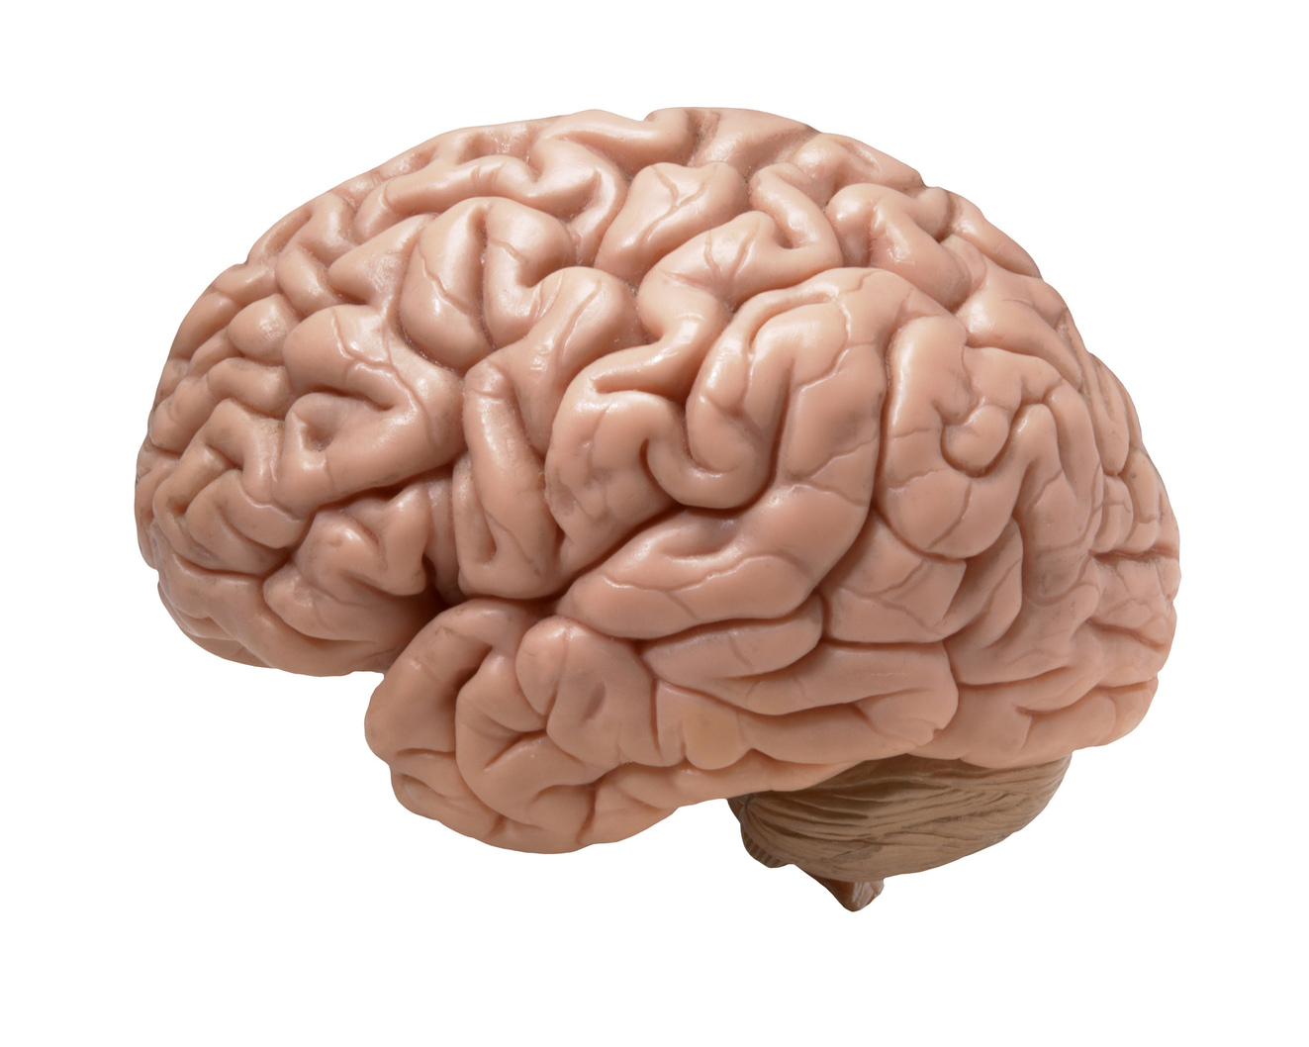
The Brain

Slide 2
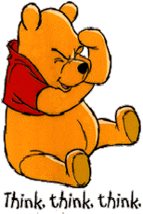
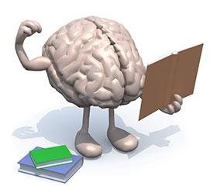
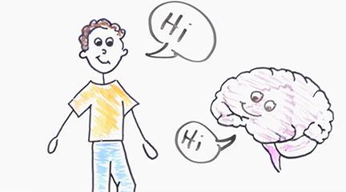
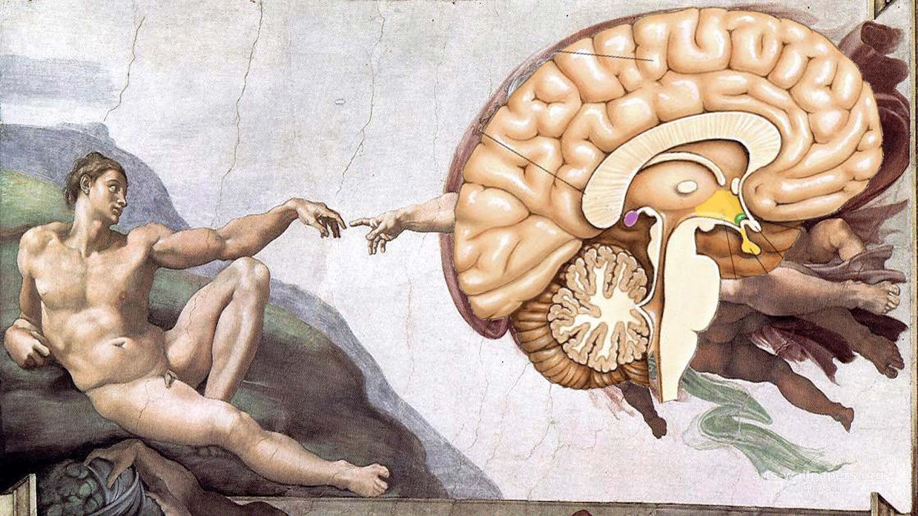
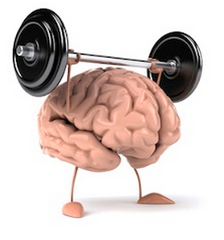
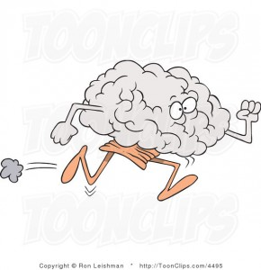

What do we need our brain for?
Notes:
Each section of the brain has a specific job
Some areas are specialized to do just one thing, like to see or to smell
Other areas get information from all over and combine it into one message

Slide 3
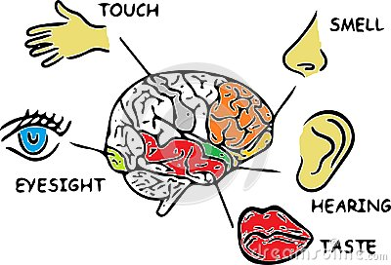
Each of the 5 senses has its place in the brain
Guess Three!
Guess Four!
Guess Five!
Guess Two!
Guess One!

Slide 4
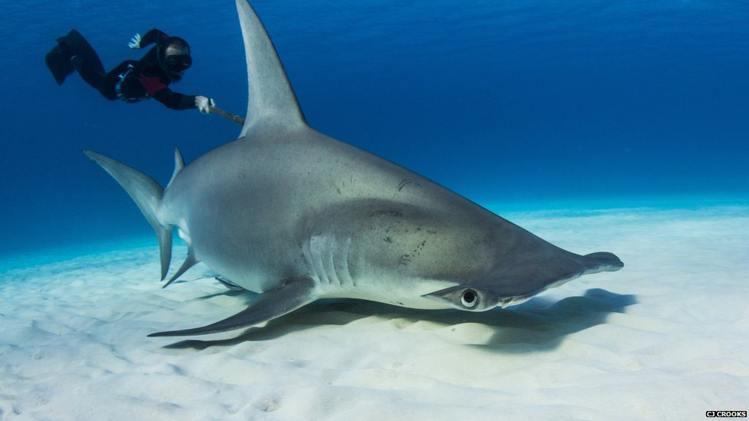
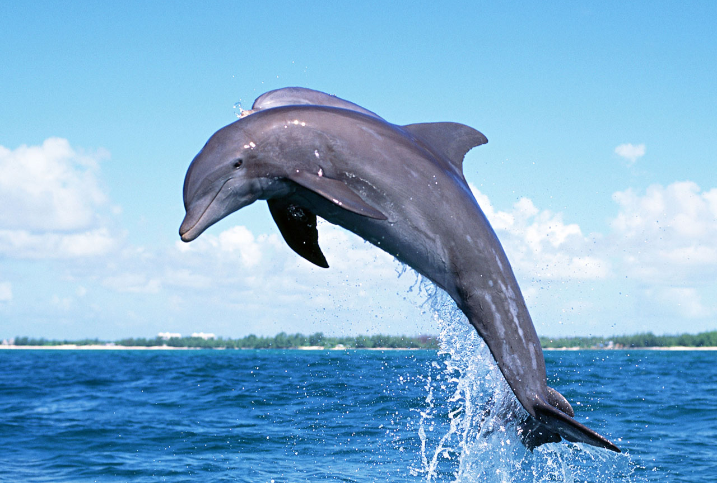
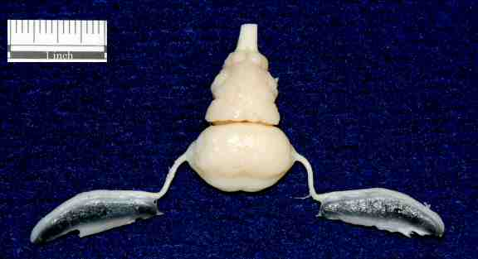
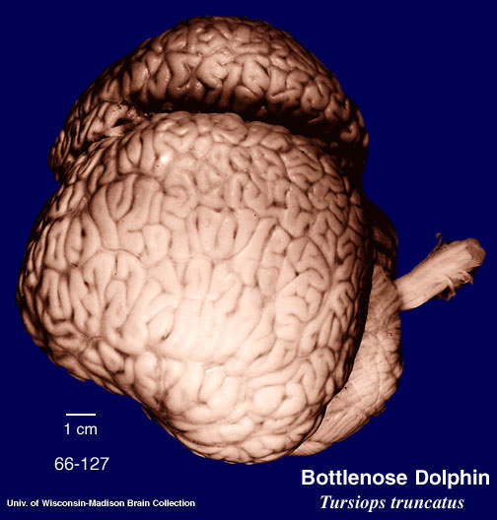
Whose brains are these?

Slide 5
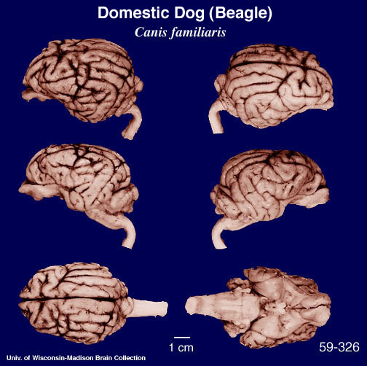
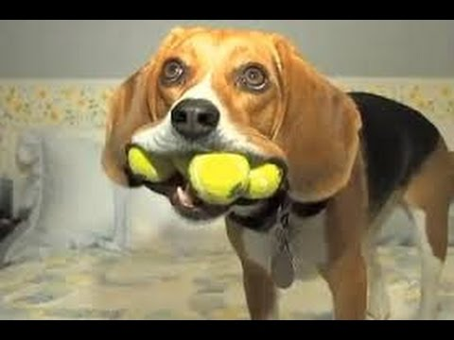
This is an animal you might find around your house, he’s got a great sense of smell and very good hearing… Give up?
It’s a dog!

Slide 6
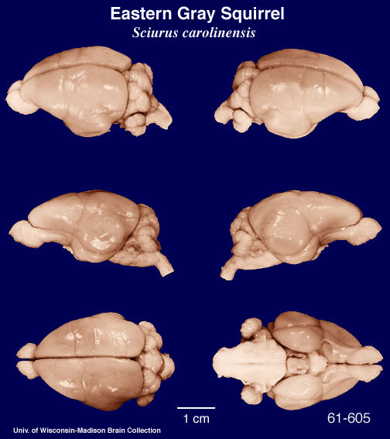
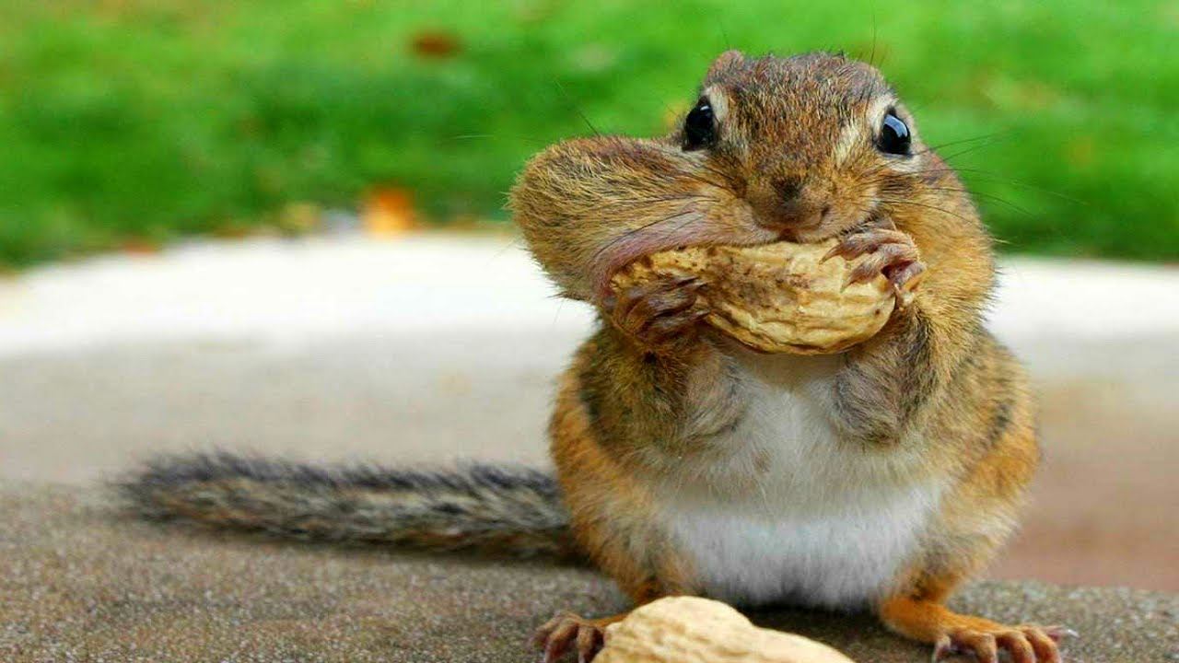
This animal might live in your backyard; they collect nuts and store them in nests inside of trees… Any Guesses?
It’s a squirrel! Do you see how smooth this brain is compared to the dolphin brain?

Slide 7
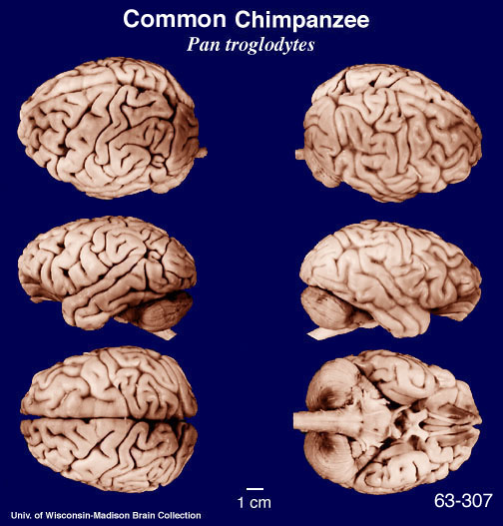
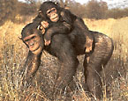
This animal lives in Africa and is our closest mammalian relative
It’s a chimpanzee! Look how similar their brains look to ours.

Slide 8
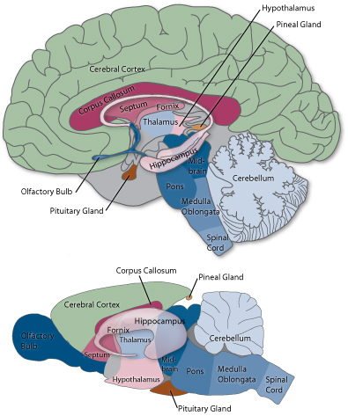
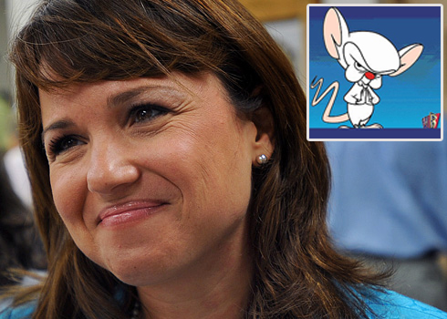
We both have the same brain parts, so what’s different between a human and a mouse?

Slide 9
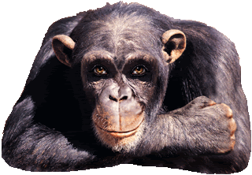

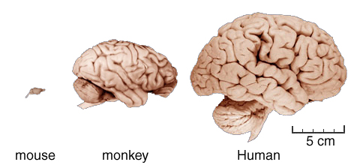
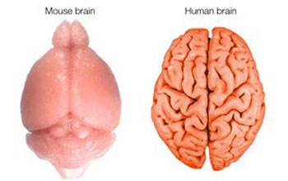
SMALLER!
SMOOTHER!

Slide 10


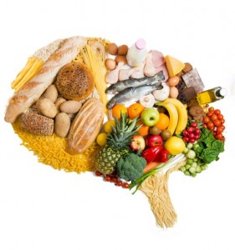
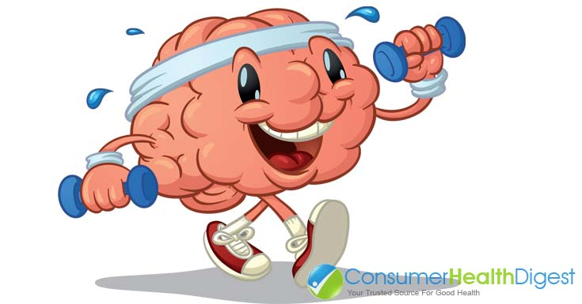
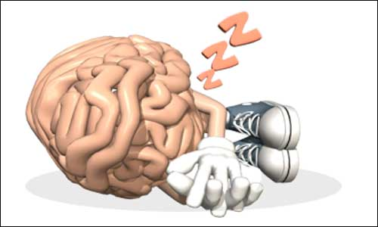
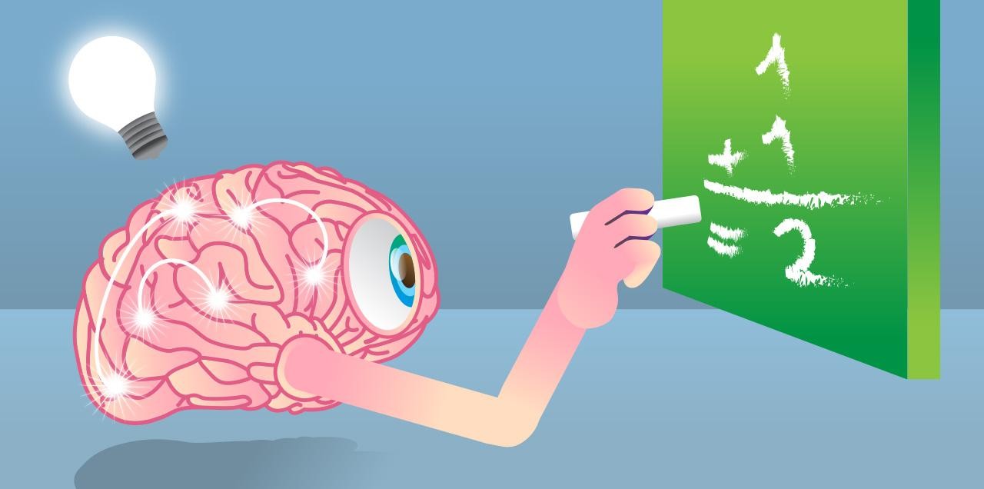
Protect your brain!
Now that you know all about the brain, how can you protect yours?
Wear a helmet!
Buckle up!
Eat fruits and veggies!
Exercise often!
Get lots of sleep!
Use your brain!

Slide 11
Thank you!!
Now who has questions???

